Slide 1

Albania
Albania: Go Your Own Way
Caitlan McCafferty
International Public Relations
June 2015

Slide 2


INTRODUCTION
Visit Albania: Go Your Own Way is a national branding campaign for Albanian tourism
Political Campaign
Addresses Albania’s national reputation on the European and Global stages
    Overall goal of replacing negative national reputation with positive ideas and images of Albania
Each image is from Visit Albania
Notes:
New campaign to encourage tourism to Albania
Also a national branding campaign
Implemented by the National Tourism Agency and the Ministry of Tourism
Tourism is becoming an important part of Albania’s economy
Albanians feel that they are still striving to remove a communist stigma from their national reputation
Albanians feel inferior to the rest of Europe
Albanians need to reach an international audience as well.
Albanians are working to become an official part of the EU

Slide 3
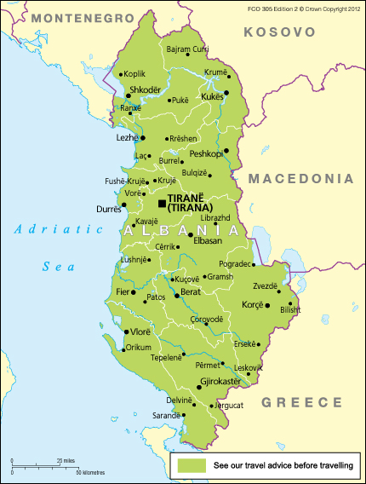
country profile
New Democracy
Free Market Economy with dreams of entering the European Union
Land of the Eagles
UNESCO World Heritage Sites
Diverse community
Free Media with a new love for Internet
https://www.gov.uk/foreign-travel-advice/albania
Notes:
Albania has suffered from occupation for the majority of its history.
Invaded by the Ottoman Empire in 1922
Invaded by Germany in 1939
Under Soviet control post- WWII
Achieved democracy in 1991 with first free election
Albanians have embraced their democracy and have a solid diplomatic relationship with the United States.
They have embraced a free market economy.
During the history of the country, the economy was heavily influenced by agriculture.
A shift has taken place focusing on the economy on the labor market.
Currently in recovery since the Global Economic Crisis
Working towards joining the EU
Diverse community complete with cultural minorities including: Albanian Kosovars, Greeks, Macedonias, Montenegrin
Diverse religious community with a majority Muslim (58%), Christian (17%)
Enjoy a free press
Internet increasing in popularity
Honor and respect folk tradition
Eagle is very important to national imagery
Warm and hospitable people

Slide 4
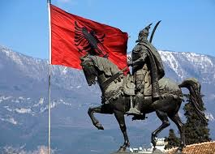
country profile: PR Implications
Must be sensitive to the communist history of the country
Highlight the country’s successes, not hardships
Respect the folk tradition
Embrace transparency
http://www.amateurradiodx.com/zaou2i-albania/
Notes:
Any PR campaign should consider the following:
The country is sensitive about the communist history and may feel inferior to the rest of the European continent.
Strong diplomatic relationship with the United States
Respect important audiences- farmers and laborers
Respect the folk tradition and the importance of it in the society
Remember that the country values a free press, so a honest and clear campaign would work best
Try a digital campaign to encourage the use and popularity of the Internet

Slide 5
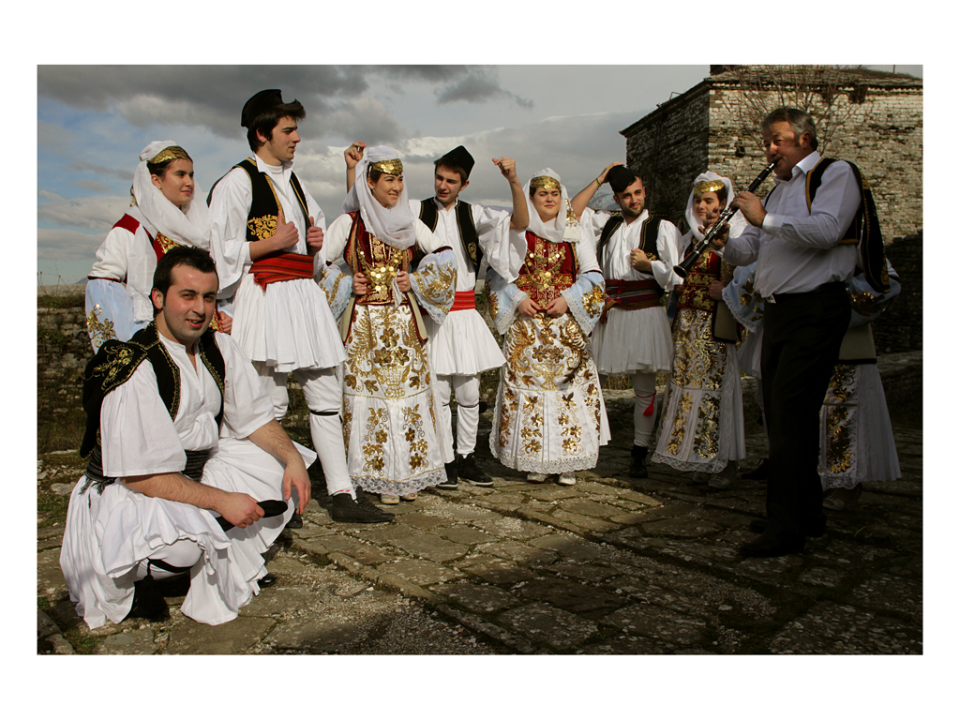
cultural profile
Low-context
Collectivist
Relationship-oriented
http://www.balkantrafik.com/wp-content/uploads/2012/10/news-albania-1.jpg
Notes:
Albania is a low-context country
Albanians are friendly and direct in their interpersonal communications
For example, writers directly discuss issues via op-eds.
Collectivist society
Family and the greater group are the priority
Many cues to working together in the current press. Example: “Only Albanian Citizens and Albanian Institutions Can Change Albania”
Loyalty is also something that is treasured in Albania
Related to the collectivist society, Albania is very relationship –oriented
Albanians are notorious for looking to peers for “help”. Usually it just means that the other person is completing the task.
The concept of cheating doesn’t exist in Albania, “cheating is sharing”.

Slide 6
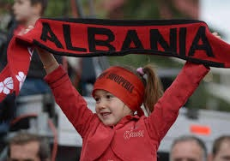
cultural profile: PR Implications
Value direct, explicit language and messaging
Respect family values and honor
the collective over the individual
Recognize the importance of
relationships in success
http://www.chinadaily.com.cn/photo/images/attachement/jpg/site1/20121129/0023ae9885da1221351e20.jpg
Notes:
Clear, concise messaging is key in Albania PR
Consider the family and other interpersonal connections
For example, opportunity for peer-peer communication is a successful tactic
Albanians will trust other Albanians
Loyalty is key
Work collaboratively
Do not rely on the idea of a “task”
It would be more prudent to focus on the relationships built between partners in the campaign. For example, between the corporation and the communications team. Or, the C-suite and the communications team. Or, a partnering organization and the representatives of the primary corporation or organization.

Slide 7

case profile
Who?
  Visit Albania
  National Tourism Agency, Ministry of Tourism
What ?
  National Branding Campaign
When?
  Launched in 2014
  Ongoing
Why?
  Necessary for Albania to establish its place in Europe
  Separate the country from communist history and negative reputation
Visit Albania
Notes:
With the help of U.S. based agencies, APCO Worldwide and StrawberryFrog, Albania reignited interest in the country as a tourism destination.
The Albanian government wanted to remind people of the beautiful things that the country has to offer
UNESCO Heritage sites, beaches, great food
The campaign wanted to brand the country as the new frontier. According to 355 Magazine, the ad copy from APCO and StrawberryFrog included the following language: “Beaches, mountains, cafes, ancient cities, Every European country has them, but Albania has something they don’t have. The Future. Albania is wide open, ready to be discovered, by adventurous travelers and innovative businesses. Go your own way will make Albania the most exciting new discovery in Europe.”
Prime Minister and Minister of Tourism wanted the campaign to curb the negative reputation that Albania had acquired over the years for numerous factors – former communist country, conflicts with neighboring countries
Before the campaign, tourism revenue was dropping for 4 years (355 Magazine).
INSTAT , the country’s statistical institute, showed that the number of foreign tourists dropped from 3.51 million to 3.46 million between 2012 and 2013. (355 Magazine).
Despite the decline, tourism remained to be one of the more important parts of Albania’s economy.

Slide 8
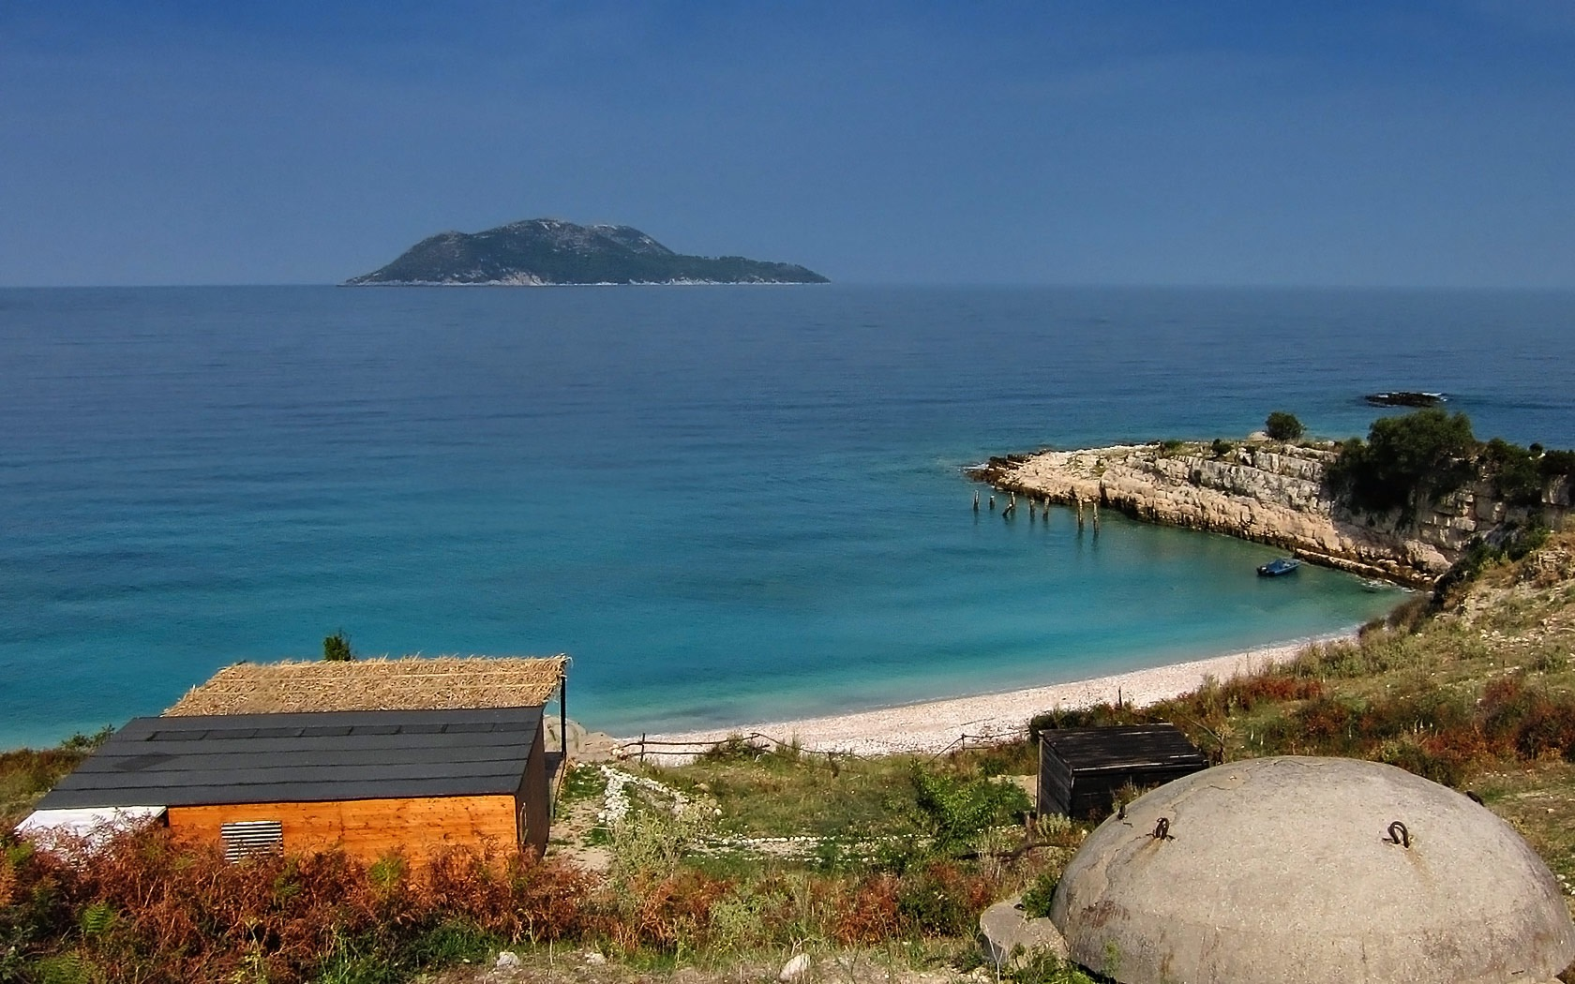
OVERALL GOALS
Increase tourism in Albania
Bolster Albanian economy
Address European inferiority complex
Show the world what Albania has to offer
Visit Albania
Notes:
First and foremost, the concerns around the national branding campaign were economic and political.
As it was briefly touched upon in the previous slide, tourism is hugely impactful in the Albanian economy. It had the potential to supplement other parts of the Albanian economy during their economic recovery.
But, even more importantly Albania wanted to change their reputation.
In the past, the negative reputation was created by the communist past and the Kosovo conflict of the late 1990s.
Wanted to create positive imagery for Albania
Remind people that Albania is just as beautiful as its Croatian and Greek neighbors
“Final Frontier” message
Albania is the next European hotspot
It is the destination for new and exciting things
It is the destination for innovative businesses

Slide 9
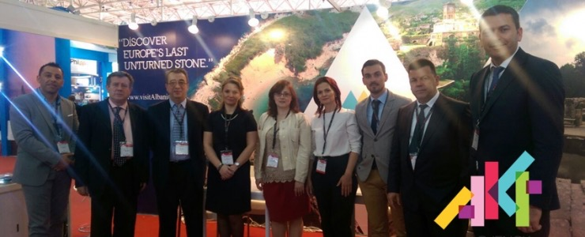
TARGET AUDIENCE
Europeans
  Regional Neighbors
International Citizens
National Tourism Agency presenting at International
Tourism Conference in China, Visit Albania
Notes:
European audience crucial for the branding campaign
Other Europeans are the people most likely to visit
Presented the campaign in Italy, Belgium, Czech-Republic, Spain, London
Ethnic Albanians from Kosovo, Macedonia, and Montenegro account for three-fifths of the tourists visiting Albania (355 Mag)
Referred to as “patriotic tourism” (355 Mag)
The campaign also held Business to Business marketing meetings in Kosovo and Turkey
Also targeting international citizen
Presented the campaign in China
American audience also targeted
Featured in New York Times as top tourism destination

Slide 10
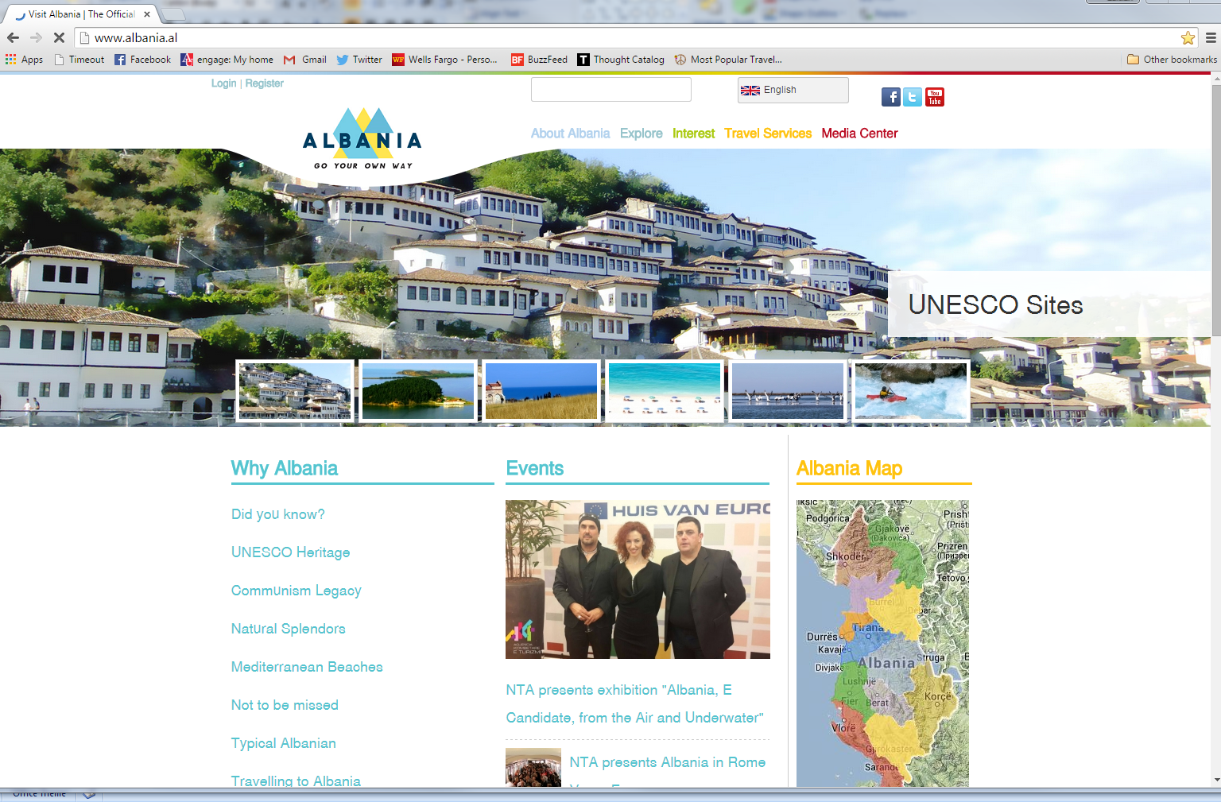
CHANNELS
Website
Social Media
Press
Partnerships
Tourism Conventions
Visit Albania website
Notes:
Website has all the information any interested party would need
Includes About Albania page that includes sections on history, geography, health & safety, travel tips, and other useful information
Include Explore page with details about the regions of Albania and their cultural and natural heritages.
Includes Interest page with details of activities available for tourists
Includes Travel Services page with details for accommodations, transportation, and dining
Includes Media Center with updates from the Visit Albania
Updates Twitter and Facebook pages regularly
Partnerships are key in this campaign
Partnerships include: Ministry of Tourism, USAID Albania
Featured in Travel Trade Gazette
Presented at The Bishopsgate of London in London, Regional Economic Conference of the Western Balkans in Montenegro, International Fair of Tourism, Travel, and Hospitality in Prishtina, International Tourism Fair COTTM in China, ITB Berlin 2015 in Berlin, Tourist Fair BIT in Milan, the Holiday World Fair in Prague and many more

Slide 11
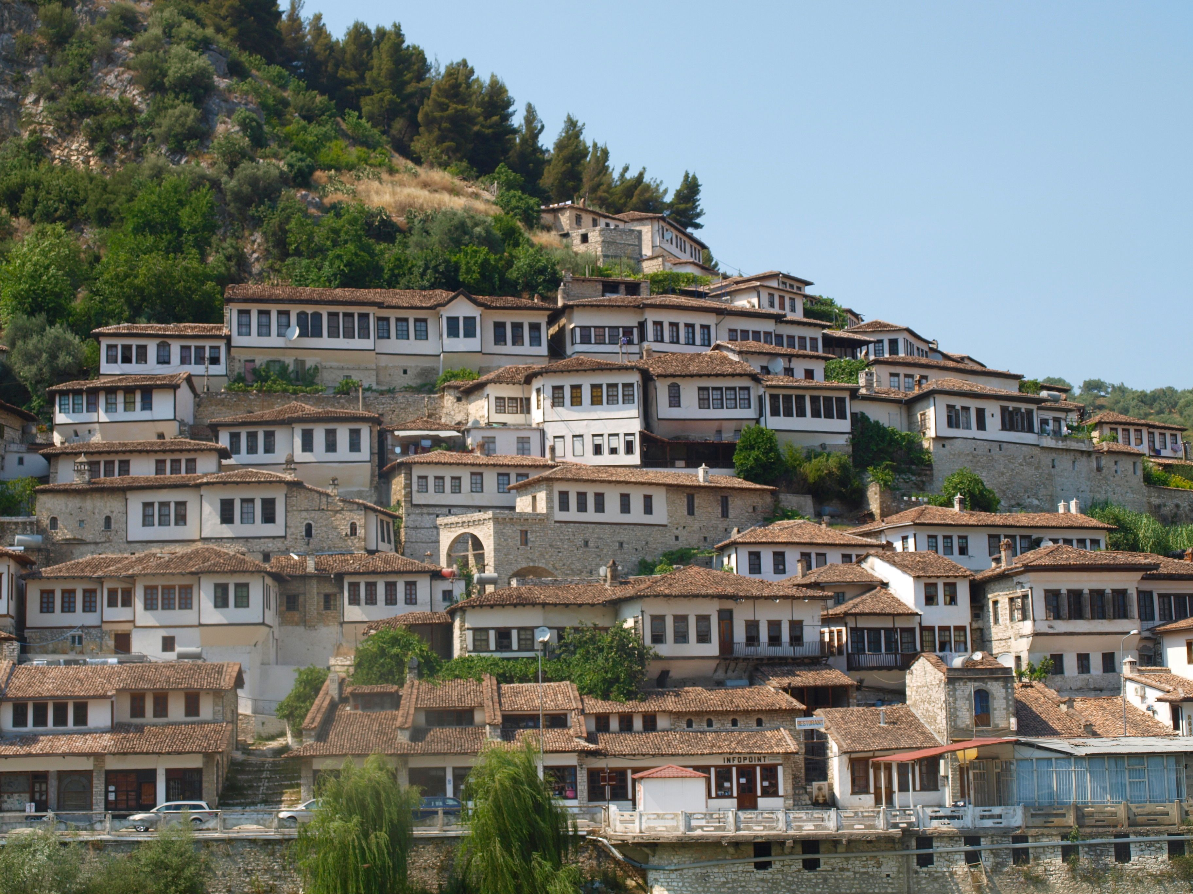
EVALUATION
Generally regarded as a success
Albania is adding a 2nd international airport due to higher tourist rates
Plans to make a former military base a tourist attraction
http://www.keytoursalbania.com/
Notes:
Campaign achieved something great when Albania was selected for Pope Francis’ visit
In the first quarter of 2014, foreign tourists increased 26.6%
Number of foreign visitors was 54,329 for the first quarter of 2014, compared to 31,020 for the same time in 2013
98.2% of visits were personal (holiday/vacation purposes, visits to friends and family, religious visits)
This is an increase of 26.9%
In 2014, the leisure travel spending was expected to grow 5.2% .
In 2014, travel and tourism supported 41,000 jobs in Albania.
2014 saw a rise of 4.1% in travel investment.
Tourism’s contribution to Albania’s GDP is expected to go from 4.8% in 2013 to 6.1% in 2024.
In 2015, Albania has started plans for a second airport.
Also in 2015, Albania has started plans for Sazan Island. It is a former military base on a isolated island in the Adriatic Sea. If renovated, it could be a historical and beautiful tourist attraction.

Slide 12
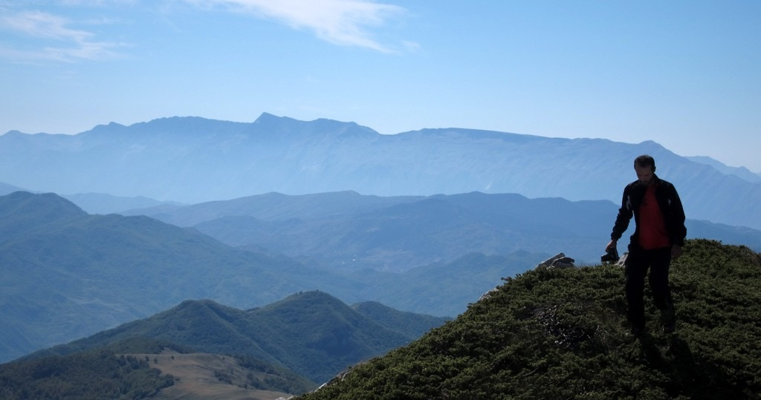
CASE ANALYSIS
  Political
  Campaign focused on creating a “national brand” for Albania
  National image is a “fixed asset”
  This campaign was initiated to start changing the national image that Albania had acquired over the generations.
  Tourism promotion a crucial part of any national brand. It is the direct communication with intended audiences.
http://www.palmtreeproduction.com/Hikes%20and%20Climbs/Albania%20Climbs/Ostrovice/data/images1/img_6786.jpg
Notes:
The Visit Albania: Go Your Own Way campaign is political.
According to Simon Anholt, national image is a “fixed asset” (34). It is created by stereotypes that allow people to categorize information about each country.
This also means that any attempt at changing this image will take generations, not just one campaign.
Go Your Own Way is a great start, but it won’t undo every negative stereotype that has been associated with Albania throughout history.
Tourism is one of the more important parts to changing a national brand. Visitors spread the word about the country in either a positive or negative way depending on the success of the campaign.
Other important parts of a nation branding campaign include: exported products, policy decisions, country’s attitude toward foreign investment, cultural exchange, and finally, the citizens themselves and how they portray the country and culture abroad and with visitors.

Slide 13
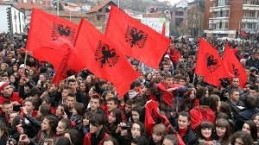
CASE ANALYSIS
One of Visit Albania’s messages was that Albania is Europe’s “last unturned stone”.
Attempted to show that Albania has the European charm of other more popular tourist destinations
Working to solidify the idea that Albania is a European nation
http://www.universitytimes.ie/?p=25498
Notes:
The image of instability has plagued Albania since the fall of communism.
Since the fall of communism, Albania and the rest of the Balkans have relied on assistance from Western Europe.
It has been a struggle for Albania to achieve consideration to become a EU member
This separation or difference from other European nations makes Albania be seen as “lesser than” or an “other”
Albania finally received Candidate status from the EU in 2014.
The EU advised that Albania still had a lot of work to do to curb organized crime and corruption. However, the candidacy encourages a positive national brand and reinforces the work that Visit Albania started.

Slide 14
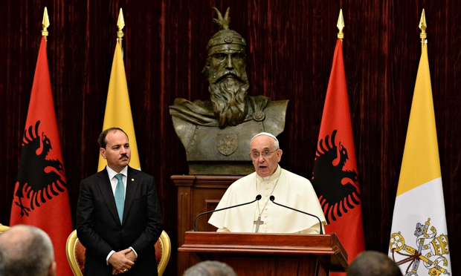
CASE ANALYSIS
Visit Albania : Go Your Own Way is an appropriate campaign for Albania.
Highlighted interpersonal communication with Tourism Conventions.
Campaign values facets of the country that Albanians value.
Pope Francis and Albanian President
Bujar Nishani during the Papal Visit to Albania in 2014. http://www.ctvnews.ca/polopoly_fs/1.2017207.1411304052!/httpImage/image.jpg_gen/derivatives/landscape_620/image.jpg
Notes:
Campaign was appropriate for Albania and shows the marks of Albania’s country and culture profile.
The campaign respects and recognizes Albania’s history – communist and otherwise.
For example, Visit Albania provided information about military structures that were left by the Communist regime and that can now be seen as a historical site.
Highlights the UNESCO heritage sites and the geographical beauty of the country as a reason to visit.
Uses direct language in the messaging supporting Albania’s low-context ideal
Highlights collectivist society and relationship-oriented nature with tactics
For example, Albanians are successful at tourism conventions where they can make connections to their audience.

Slide 15
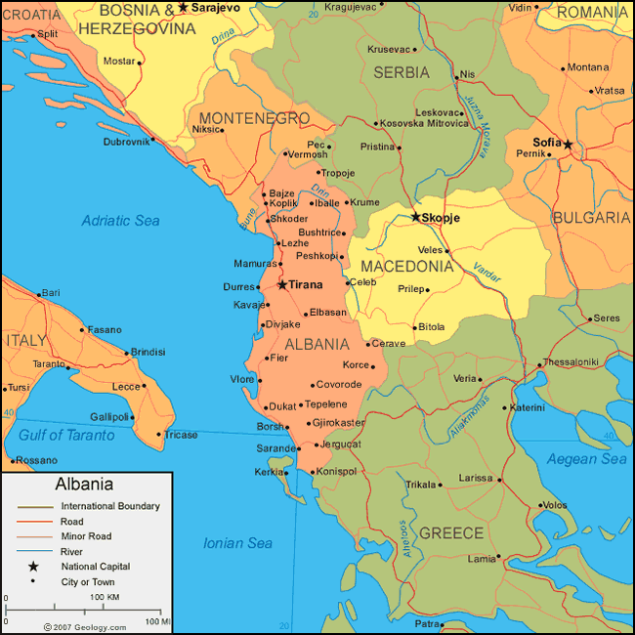
CONCLUSION
Campaign initiated to curb national negative reputation
Visit Albania: Go Your Own Way used traditional media, social media, and tourism conventions to spread the word.
Appropriate for Albanian and international audiences
Regarded as a success
The first step in the long process of changing a national brand.
http://geology.com/world/albania-map.gif
Notes:
The campaign’s primary objective was to curb Albania’s negative reputation.
It was meant to support other political goals that Albania has.
For example, it supported Albania’s attempts to become a EU member.
Visit Albania reinforced the positive attributes that Albanians love about their country.
It also benefited from Albanian’s interpersonal connections while presenting the campaign internationally.
Overall, the campaign has been a major success, but it is a first step in a long battle against Albanian’s long standing negative reputation.

Slide 16
Resources
(14 May 2014) Derelict military island in Albania to become tourist attraction. Telegraph. Retrieved from: http://www.telegraph.co.uk/travel/travelnews/11602140/Derelict-military-island-in-Albania-to-become-tourist-attraction.html
(21 May 2014) ‘Go your own way’ Albania tells the world, launching new global marketing campaign. 355 Magazine. Retrieved from: https://355mag.wordpress.com/2014/05/21/go-your-own-way-albania-tells-the-world-launching-new-global-marketing-campaign/
(6 June 2014) Albania Wins EU Candidate Status. Visit Albania. Retrieved from: http://www.albania.al/content/albania-wins-eu-candidate-status
(11 July 2014) Statistics of Tourism. Visit Albania. Retrieved from: http://www.albania.al/content/statistics-tourism
(May 8, 2015)“Only Albanian Citizens and Albanian Institutes Can Change Albania” Albanian News. Retrieved from http://www.albaniannews.com/index.php?idm=1384&mod=2.
(11 June 2015) Tourism: Albania isn’t only about sea, culture main asset. ANSAmed. Retrieved from: http://www.ansamed.info/ansamed/en/news/sections/tourism/2015/06/11/tourism-albania-isnt-only-about-sea-culture-main-asset_c632c580-9aa6-481f-85c3-9b460cd617f7.html?idPhoto=1
(14 June 2015) Albania presents its tourism in China. Visit Albania. Retrieved from: http://www.albania.al/content/albania-presents-its-tourism-china
(22 June 2015). Albania to add 2nd international airport as tourism grows. Property Investor Europe. Retrieved from: https://www.pie-mag.com/articles/9941/albania-to-add-2nd-international-airport-as-tourism-grows/
Albania. The Hofstede Center. Retrieved from http://geert-hofstede.com/albania.html.
Albania. The World Bank. http://www.worldbank.org/en/country/albania/projects
Albania. The World Factbook. https://www.cia.gov/library/publications/the-world-factbook/geos/al.html
Albania Population 2015. World Population Review. Retrieved from: http://worldpopulationreview.com/countries/albania-population/
Anholt, S. (2008). The importance of national reputation. In Welsh, J & Fearn, D(Eds.) Engagement: Public Diplomacy in Globalised World (pp. 30-43). UK: Foreign Commonwealth Office. Retrieved from: http://uscpublicdiplomacy.org/book_review/engagement_public_diplomacy_in_a_gloalised_world/
Cultural Heritage. Albanian: Go Your Own Way. http://www.albania.al/explore/cultural-heritage
Cultural Profile, Centre for Intercultural Learning. Retrieved fromhttp://www.intercultures.ca/cil-cai/ci-ic-eng.asp?iso=al#tphp.
A Kosovo Chronology. PBS. http://www.pbs.org/wgbh/pages/frontline/shows/kosovo/etc/cron.html
Economic Impact 2014 – Albania. (2014). Travel & Tourism. Retrieved from: http://www.wttc.org/-/media/files/reports/economic%20impact%20research/country%20reports/albania2014.pdf
Hall, D. (2001). Albania in Europe: Condemned to the Periphery or Beyond?. Geopolitics, 6(1), 107.
Media Center - Press. Visit Albania. Retrieved from: http://www.albania.al/media-center/press/International
U.S. Relations with Albania. U.S. Department of State. http://www.state.gov/r/pa/ei/bgn/3235.htm
Visit Albania Facebook. Visit Albania. Retrieved from: https://www.facebook.com/VisitAlbania.al?fref=ts
Visit Albania: Go Your Own Way. Visit Albania. Retrieved from: http://www.albania.al/
Visit Albania Twitter. Visit Albania. Retrieved from: https://twitter.com/visit_albania

Slide 17
THANK YOU!
Caitlan McCafferty
International Public Relations – June 2015
caitlan.mccafferty@gmail.com

